Slide 1

Stock Analyzer - FlaskApp
MASY 3540
Kirsten Pan, Carlos Olivella, Antonio Mayol, Mariella Acebal

Slide 2
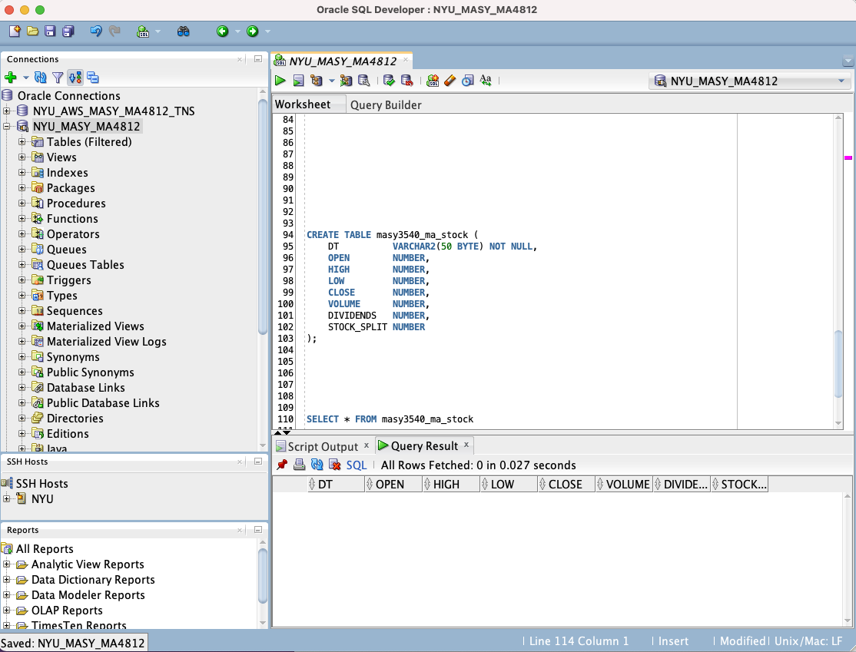
Creating the table
Stock Analyzer - Flask App
Kirsten Pan, Carlos Olivella, Antonio Mayol, Mariella Acebal

Slide 3
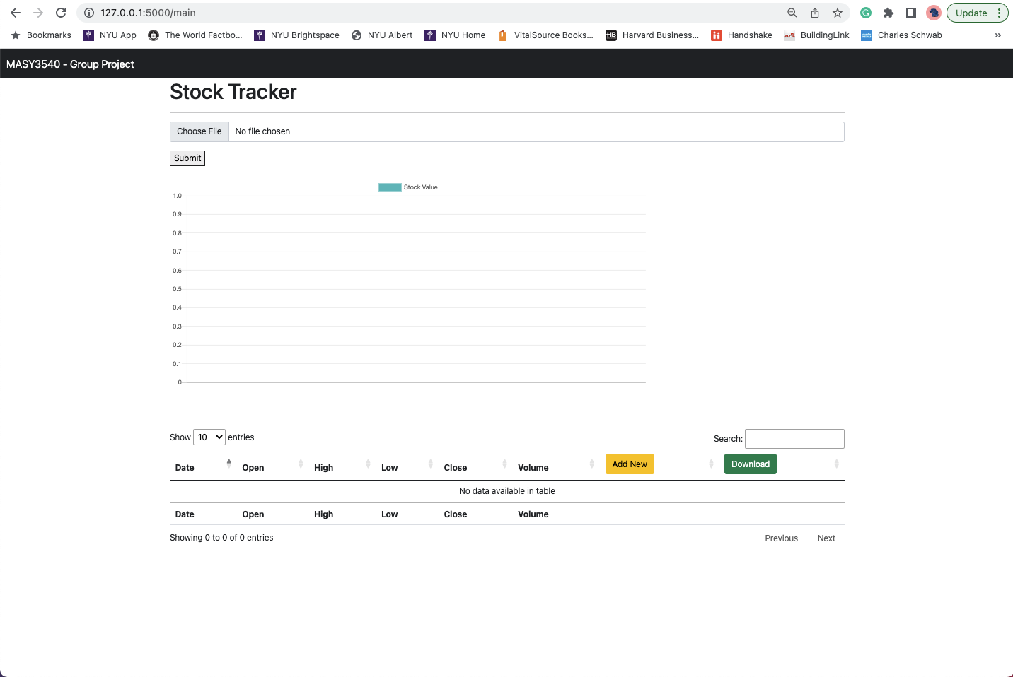
Main Page (no upload yet)
Stock Analyzer - Flask App
Kristen Pan, Carlos Olivella, Antonio Mayol, Mariella Acebal

Slide 4
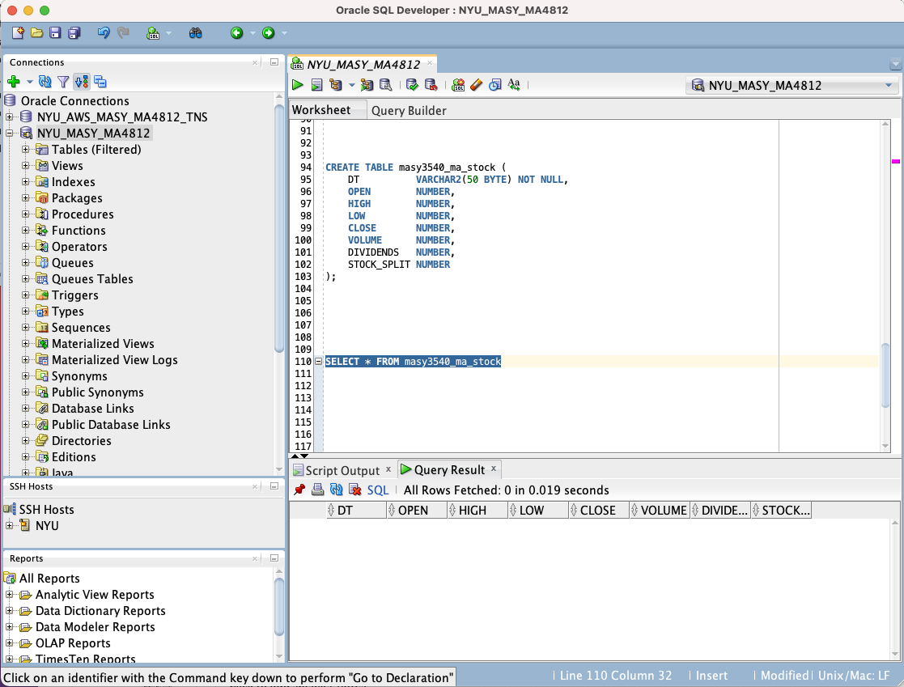
Database Showing Empty
Stock Analyzer - Flask App
Kristen Pan, Carlos Olivella, Antonio Mayol, Mariella Acebal

Slide 5
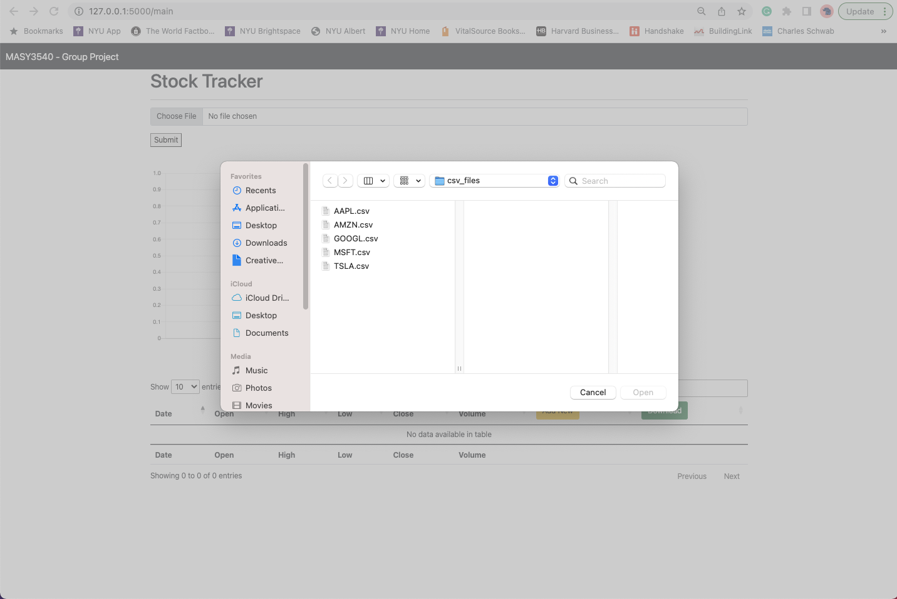
Data Upload (choosing CSV file)
Stock Analyzer - Flask App
Kristen Pan, Carlos Olivella, Antonio Mayol, Mariella Acebal

Slide 6
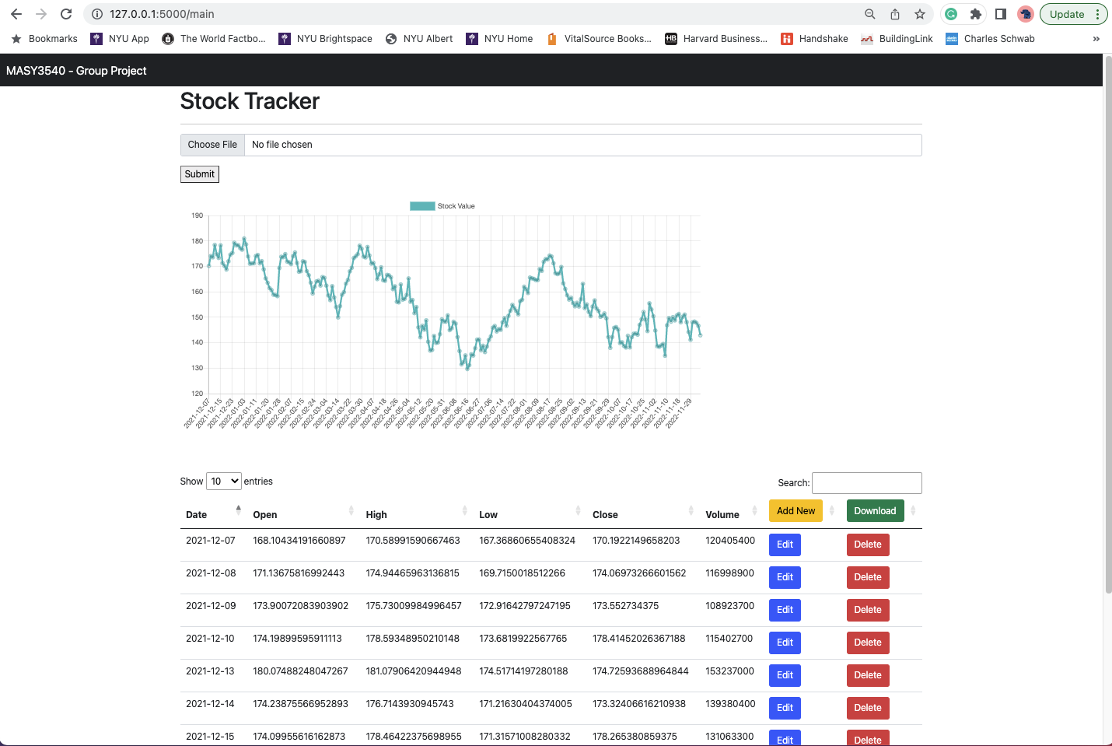
Main Page (uploaded one CSV)
Stock Analyzer - Flask App
Kristen Pan, Carlos Olivella, Antonio Mayol, Mariella Acebal

Slide 7
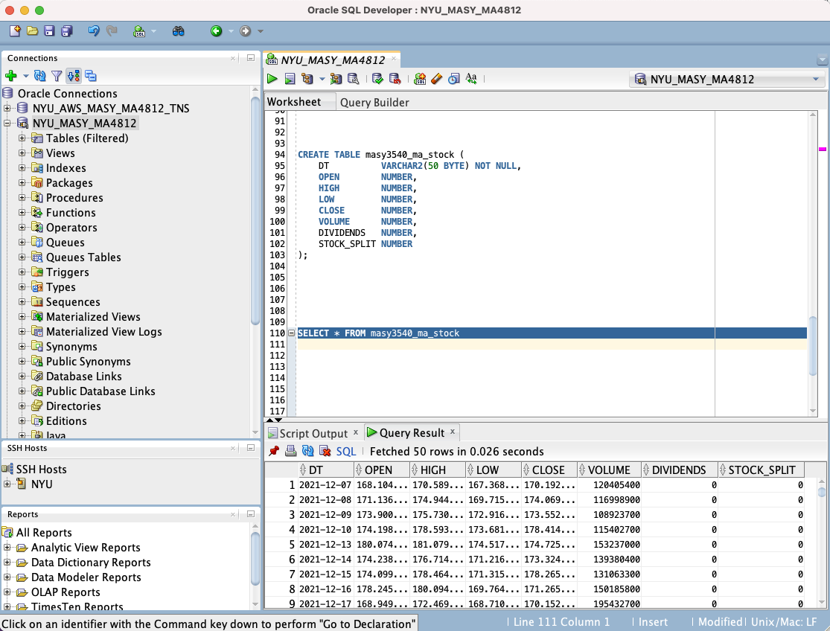
Database Showing Data Uploaded
Stock Analyzer - Flask App
Kristen Pan, Carlos Olivella, Antonio Mayol, Mariella Acebal

Slide 8
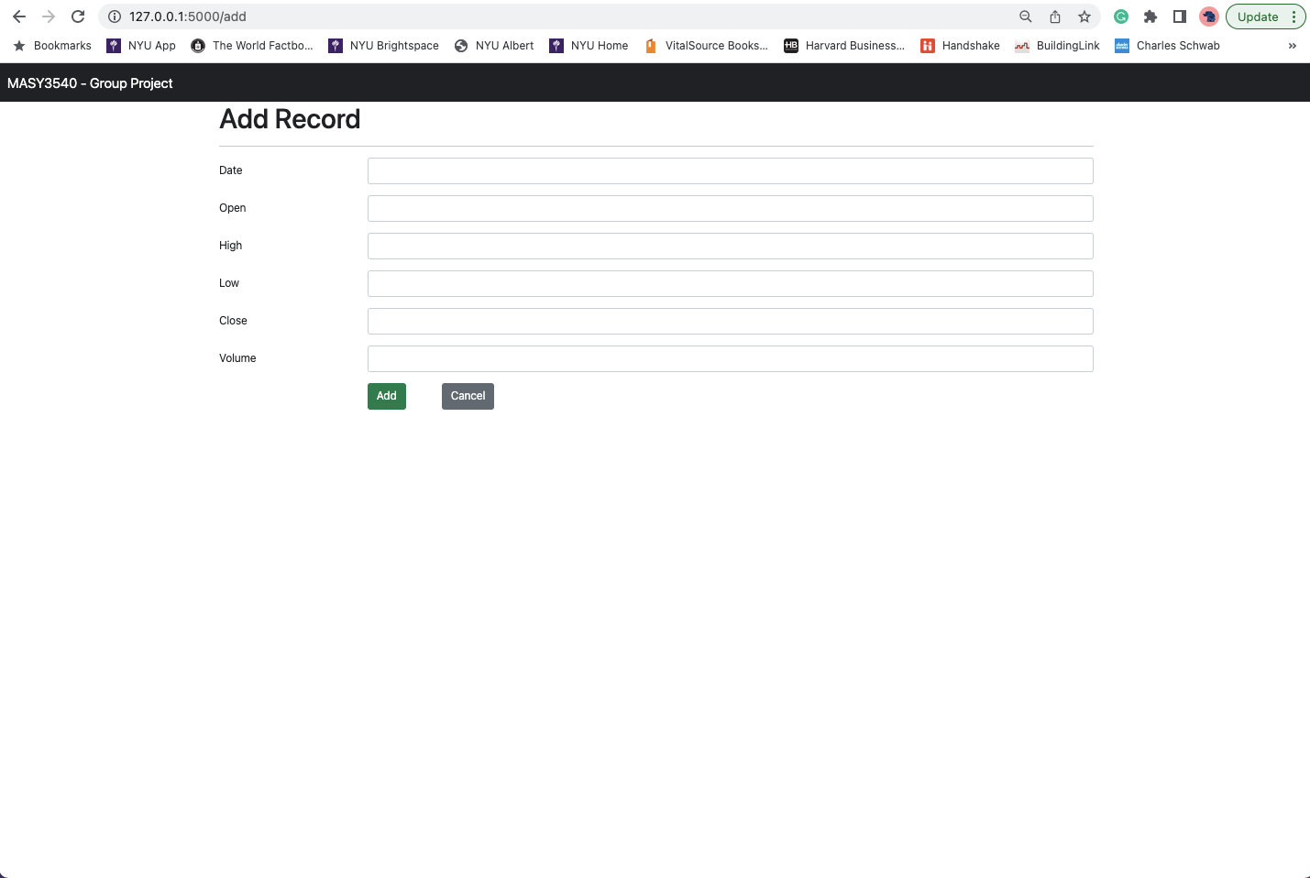
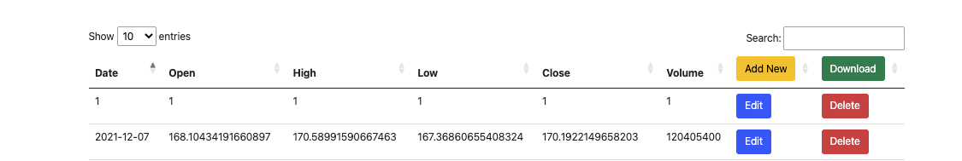
Add
Stock Analyzer - Flask App
Kristen Pan, Carlos Olivella, Antonio Mayol, Mariella Acebal

Slide 9
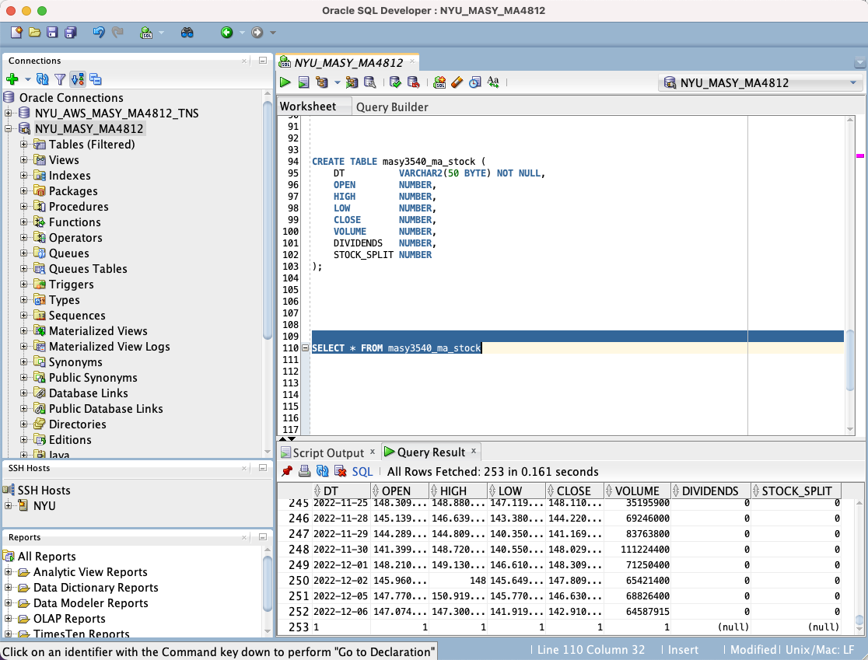
Database Showing Added Value
Stock Analyzer - Flask App
Kristen Pan, Carlos Olivella, Antonio Mayol, Mariella Acebal

Slide 10
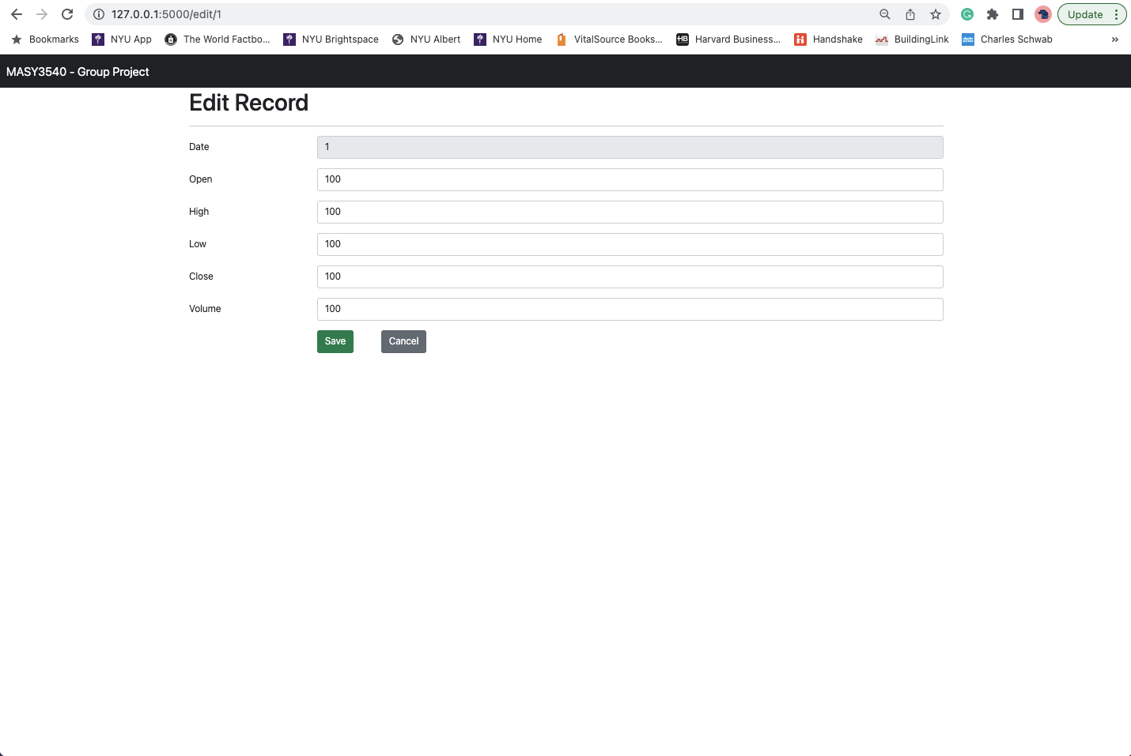
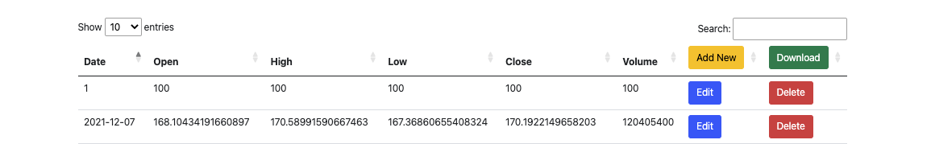
Edit
Stock Analyzer - Flask App
Kristen Pan, Carlos Olivella, Antonio Mayol, Mariella Acebal

Slide 11

Database Showing Edited Value
Stock Analyzer - Flask App
Kristen Pan, Carlos Olivella, Antonio Mayol, Mariella Acebal

Slide 12
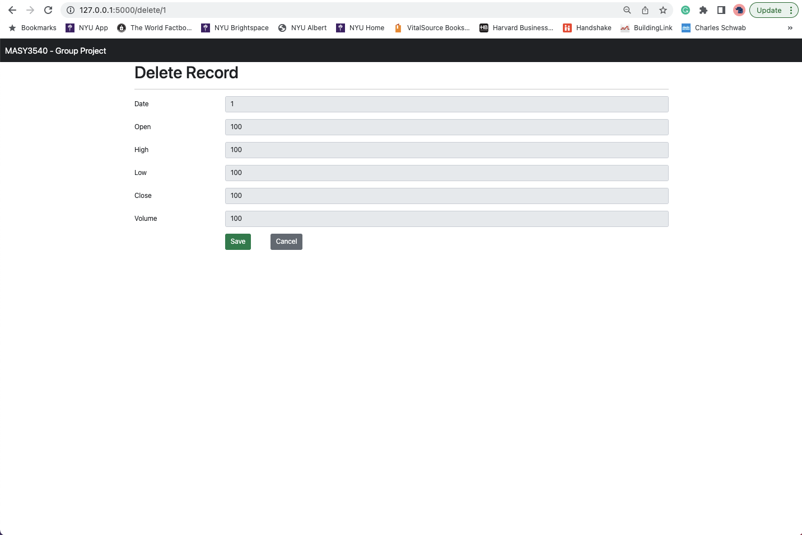
Delete
Stock Analyzer - Flask App
Kristen Pan, Carlos Olivella, Antonio Mayol, Mariella Acebal

Slide 13

Database Showing Deleted Value
Stock Analyzer - Flask App
Kristen Pan, Carlos Olivella, Antonio Mayol, Mariella Acebal

Slide 14
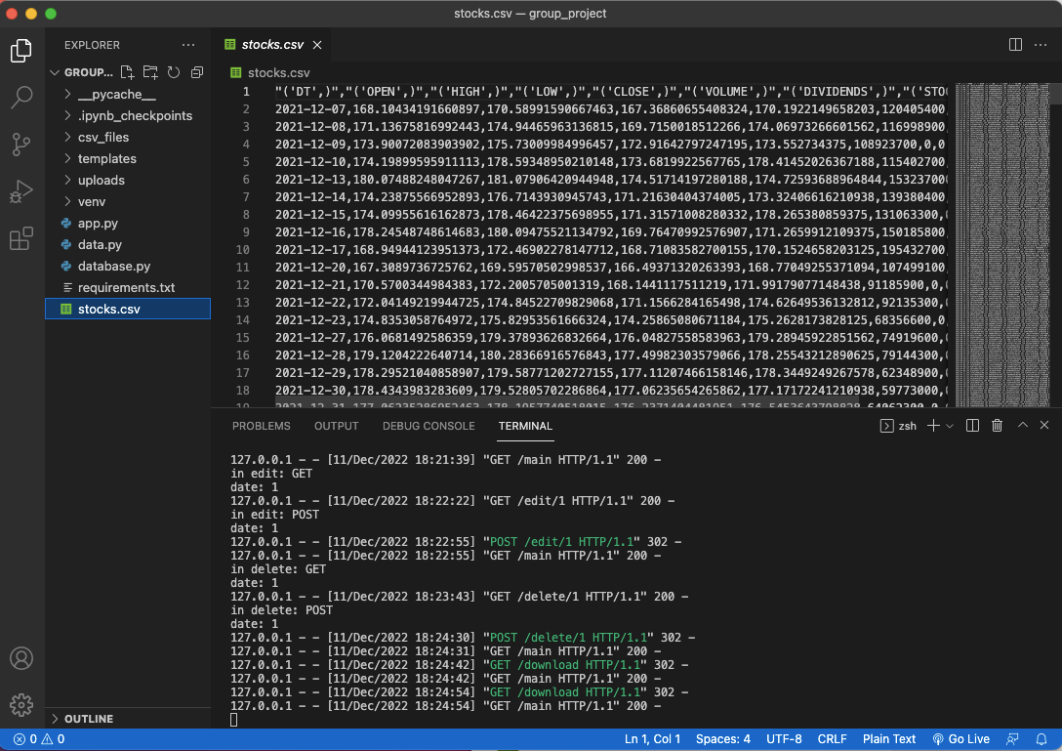
Download
Stock Analyzer - Flask App
Kristen Pan, Carlos Olivella, Antonio Mayol, Mariella Acebal

Slide 15
Thank You!
MASY 3540
Kristen Pan, Carlos Olivella, Antonio Mayol, Mariella Acebal

